Slide 1


|| JAI SRI GURUDEV ||
ADICHUNCHANAGIRI UNIVERSITY
BGS INSTITUTE OF TECHNOLOGY
BG Nagara – 571448, Nagamangala Taluk, Mandya District, Karnataka(INDIA)
An Internship Presentation On
“ OBJECT DETECTION FOR BLIND PERSONS –BLIND VISION SYSTEM USING ML”
BACHELOR OF ENGINEERING
IN
ELECTRONICS AND COMMUNICATION ENGINEERING
Under the guidance of:
Dr. M.B. Anandaraju, _{M.E, Ph.D.}
Director-HR, ACU
Professor, Dept. of ECE,
BGSIT, BG Nagar, Mandya.
Submitted by:
Divya H S
20ECE028
8 th sem, A sec
Dept. of ECE

Slide 2
CONTENTS
Aim
Introduction Of Company
Introduction of Domain
Tasks Performed
Reflection Notes
Conclusion

Slide 3
AIM
To develop a Blind Vision System using Machine Learning (ML) to empower visually impaired individuals in navigating their environment independently.
By harnessing the capabilities of computer vision and object detection algorithms, the system aims to detect and identify common objects and obstacles in real-time, providing users with essential information about their surroundings.
Through a user-centric approach, the system is designed to be seamlessly integrated into assistive devices, ensuring accessibility and usability for blind individuals.

Slide 4
INTRODUCTION OF COMPANY
Company Name : Contriver
Location : Mysore, Karnataka.
Founded : 07 october 2017.
Goal :The founder of Contriver wanted to create a community for the young people who are the future pillars of the nation.
Period of Internship : 1 Month(4 March 2024 – 4 April 2024).

Slide 5
Contriver is a company owned by young people who have recognized the intolerance that is possessed to the society in the field of Food, Health, Education, Agriculture, Fitness, Construction, Engineering, Fashion, Record Producing. The journey of Contriver started from the educational sector on 07-Oct-2017 at Vidyavardhaka College of engineering(VVCE), Mysore. By conducting a 12 days’ Workshop on “Professional Designing” for 5th and 7th Semester students.

Slide 6
INTRODUCTION OF DOMAIN
Python is a high-level, interpreted programming language known for its simplicity, readability, and versatility.
Python was developed in the early 1990's by Guido van Rossum, then at CWT in Amsterdam, and currently at CNRI in Virginia
It's used across various domains, from web development to data science, thanks to its clear syntax, extensive standard library, and active community support.

Slide 7
TASKS PERFORMED
Project: OBJECT DETECTION FOR BLIND PERSONS –BLIND VISION SYSTEM USING ML.
Introduction:
Navigating the world can be a significant challenge for visually impaired individuals, often relying on assistance or traditional mobility aids.
However, advancements in technology, particularly in Machine Learning (ML) and computer vision, offer new possibilities for enhancing independence and safety.
The objective of this project is to develop a Blind Vision System tailored specifically for the needs of blind individuals, utilizing ML techniques for object detection.
By leveraging ML algorithms, the system aims to detect and identify obstacles and objects in real-time, providing auditory or tactile feedback to users

Slide 8
HARDWARE/SOFTWARE REQUIREMENTS
Hardware Requirements:
1. Computer
2. Camera
3. Microphone (Optional)
4. Assistive Devices
Software Requirements:
1. Operating System
2. Programming Languages
3. Machine Learning Libraries
4. Development Environment
5. Object Detection Frameworks
6. Accessibility Tools
7. User Interface Development Tools

Slide 9
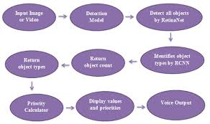
BLOCK DIAGRAM

Slide 10
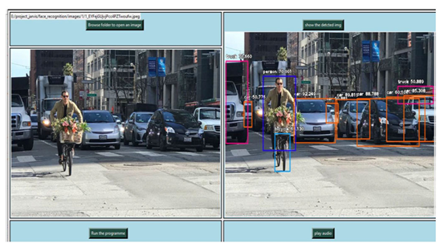
RESULT

Slide 11
REFLECTION NOTES
Technical Outcomes:
1. Accurate Object Detection
2. Robust Performance
3. Real-Time Processing
4. Low Latency
5. Adaptability
6. User-Friendly Interface
7. Compatibility
8. Integration
9. Privacy and Security
10. Scalability

Slide 12
Benefits of doing Internship
Gain valuable Work Experience
Transition into a Job
Networking Opportunities
Apply Classroom Knowledge
Gain Confidence

Slide 13
CONCLUSION
The development of a Blind Vision System using Machine Learning (ML) holds immense promise in improving the lives of visually impaired individuals.Through the integration of advanced object detection algorithms and user-centric design, this project aims to empower blind individuals to navigate their surroundings with greater confidence and independence. By leveraging ML techniques, the system can accurately detect and identify objects and obstacles in real-time, providing invaluable assistance to users in their daily activities.

Slide 14
THANK YOU

